Slide 1
Euler Paths and It’s Application
Submitted By:
Ritik Pansuriya(18IT237)
Karthik R(18IT235)
Rohit Kumar Sahu(18IT138)

Slide 2
Problem statement
How to find whether a given graph is Eulerian or not? The problem is the same as the following question. “Is it possible to draw a given graph without lifting pencil from the paper and without tracing any of the edges more than once”.
To implement Fleury’s algorithm in a diagramatic representation of the map of National Institute of Technology, Karnataka and find the shortest distance travelled by the garbage truck in collecting garbage across National Institute of Technology, Karnataka by using depth first search algorithm.

Slide 3
Objective
To learn how Euler Graph is used in real life problem.
How Fleury algorithm works on Euler Graph.
How Depth First Search works to find shortest path in Graph.
Implementation of this concept on real life problem of National Institute of Technology, Karnataka.

Slide 4
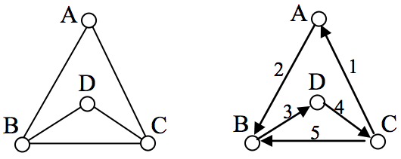
Eulerian Path
Eulerian Path is a path in graph that visits every edge exactly once. Eulerian Circuit is an Eulerian Path which starts and ends on the same vertex.
In the graph shown, there are several Euler paths. One such path is CABDCB. The path is shown in arrows to the right, with the order of edges numbered.

Slide 5
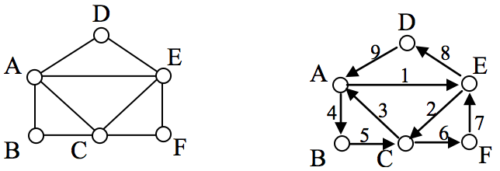
Eulerian Circuit
An Euler circuit is a circuit that uses every edge in a graph with no repeats. Being a circuit, it must start and end at the same vertex.
The graph has several possible Euler circuits. Here’s a couple, starting and ending at vertex A: ADEACEFCBA and AECABCFEDA. The second is shown in arrows.

Slide 6
Fleury's Algorithm for Finding Eulerian Path or Circuit
1. If there are odd degree vertices (there then must be exactly two if an Eulerian path is to exist), choose one. Travel over any edge whose removal will not result in breaking the graph into disconnected components.
2. Rub out the edge (or colour the edge if you like) you have just traversed, and then travel over any remaining edge whose removal will not result in breaking the remaining subgraph into disconnected components.
3. Repeat step 2 until other edges are rubbed out.

Slide 7
Depth First Search Algorithm
Depth First Search algorithm is used to travel the shortest path in Euler Graph.
Depth-first search (DFS) is an algorithm for traversing or searching tree or graph data structures.
The algorithm starts at the root node and explores as far as possible along each branch before backtracking.

Slide 8
Literature Survey
The following papers were an inspiration to this project, and have therefore been listed here:
“A study on Euler Graph and its applications” written by Ashish Kumar, M.Sc. Mathematics Department of Mathematics and Statistics, SHUATS Allahabad, U.P., India.The paper explains all the concept of Graph theory, Euler Graph, Euler theorem and Famous Chinese Postman Problem.This paper clears the concept of above mentioned topics.
“A study of fleury algorithm and its application on Euler Graph” taken from MM322 Graphs and Networks.The paper explains all concept of implementation of fleury algorithm on Euler Graph. Also it gives Euler path or cycle based on graph in which every graph is traversed only once.

Slide 9
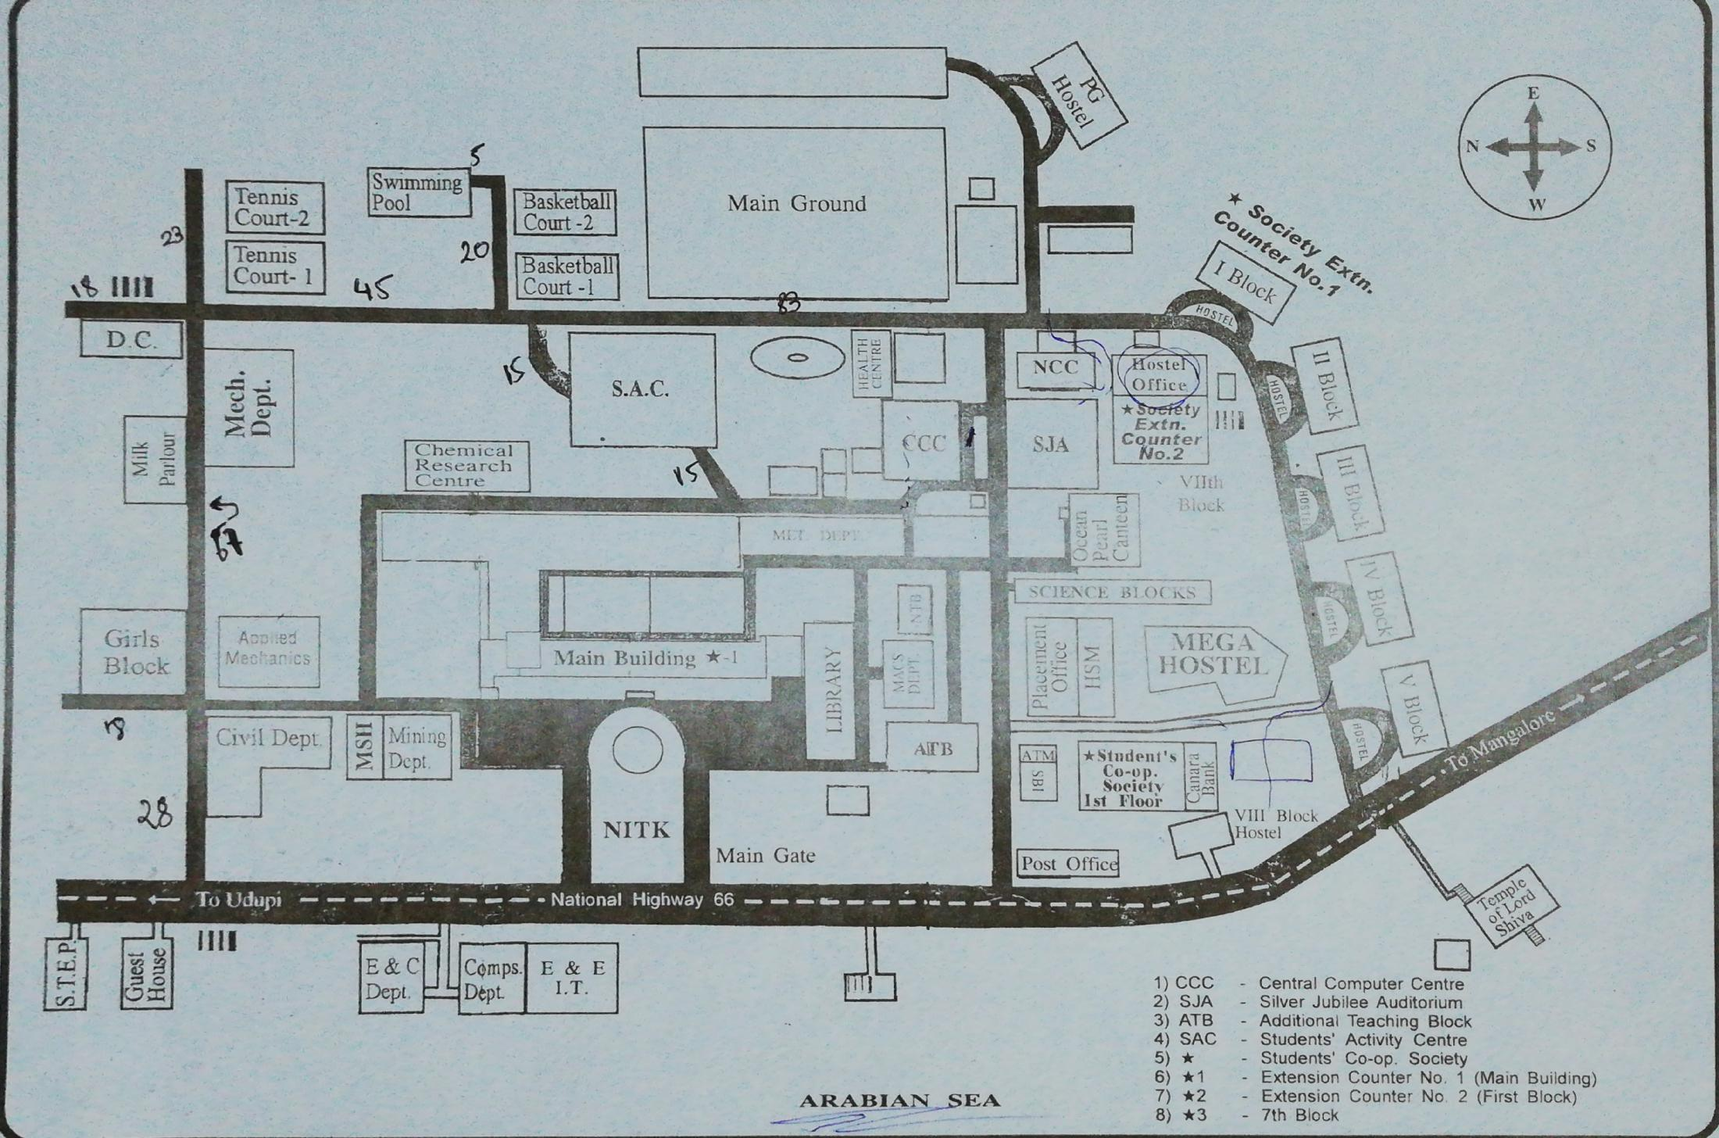
Implementation on NITK map
The map shown below is a map of Eastern Campus of National Institute of Technology, Karnataka. We are finding shortest path by which a road cleaner can travel so that every road in the below map will be cleaned.
Figure 3. Map of National I

Slide 10
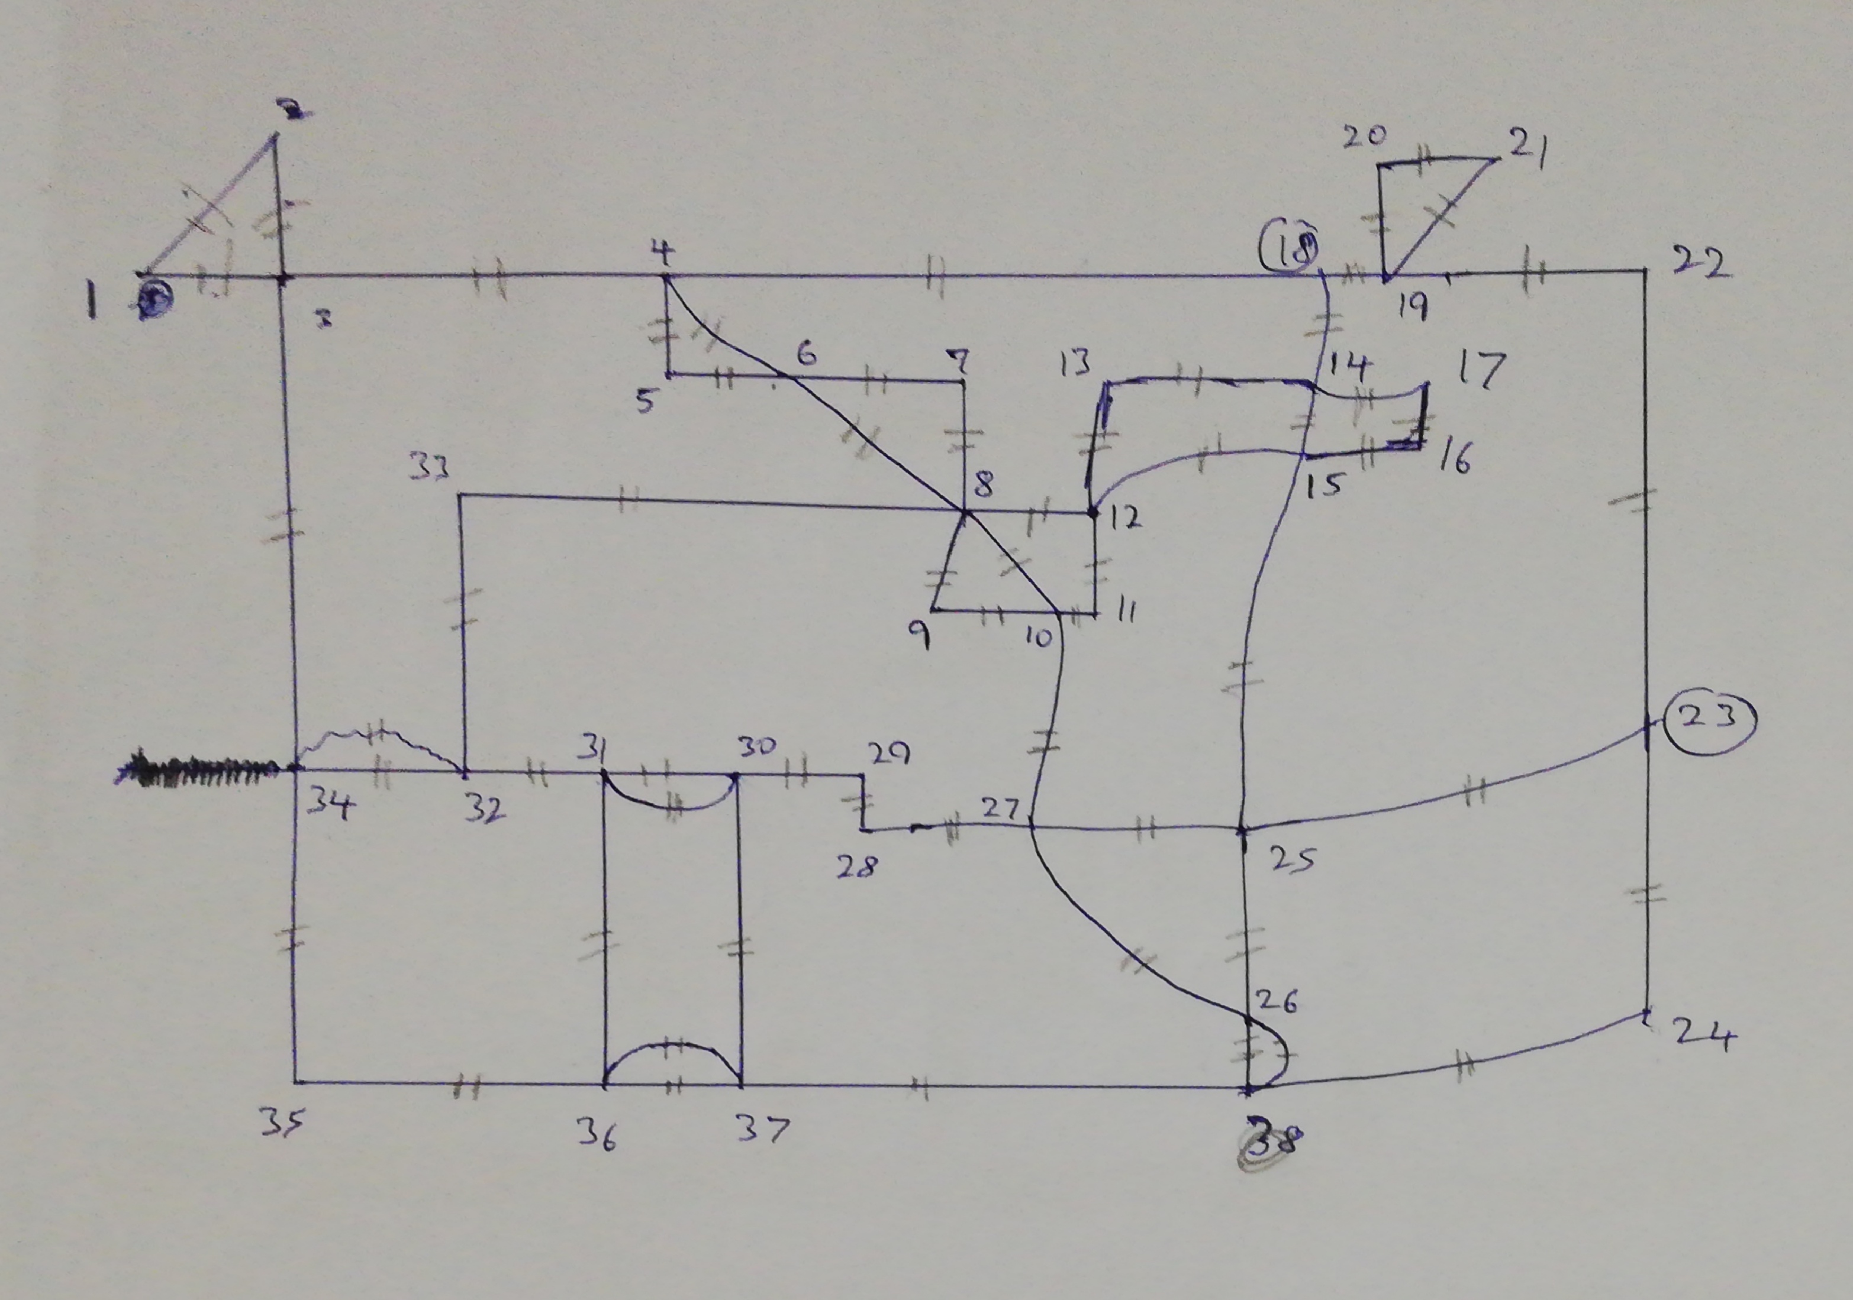
Euler graph of NITK map
Map of NITK in Euler format having the representation of graph with numbered vertices and showing the edges between them.

Slide 11
Advantages
There are many advantages of this algorithm,
First is Fleury's algorithm is very important in allowing us to be able to construct an Eulerian path given an Eulerian graph G.
Also this algorithm is completely optimal enough for all possible cases.
Efficiency takes into account the number of calculations needed to run the algorithm as the size of the problem grows. An algorithm is considered efficient in run time grows at roughly the same speed as the size of the graph increases.This algorithm is efficient even for a large number of input vertices.

Slide 12
Disavantages
Just like any other algorithm, Fleury’s algorithm comes with it’s own set of disadvantages,
For Fleury’s algorithm to be applicable,the necessary condition is that the graph must be Eulerian, if not the algorithm cannot be applied to the given graph. This significantly reduces the number of cases Fleury’s algorithm can be applied to.

Slide 13
Conclusion
Eulerian graph is applicable in many real life situations. Applications of Eulerian circuits abound. For example, Eulerian circuits are obviously desirable in the deployment of street sweepers, snowplows, buses and mail carriers. In these applications, traversing a street more than once is a waste of resources. Thus, Eulerian circuits represent optimal solutions in terms of conserving resources.
Methods such as these have been implemented and have resulted in considerable cost savings to the municipalities involved.
Implementing Fleury‘s algorithm will assist the garbage collectors in selecting the best possible path while collecting trash in the campus in minimum time with maximum efficiency.

Slide 14
References
Dvorak Tomas, Havel Ivan and Liebl Petr [1997]: “Euler cycles in the complete graph K2m+1” Discrete Mathematics, Vol. 171, pp. 89-102.
Bhatt S., Even S., Greenberg D., and Tayar R. [2002]: “Traversing directed Eulerian mazes” Journal of Graph Algorithms and Applications, Vol. 6, Series 2, pp. 157– 173..
Mcdiarmid Lolin and Michael Molloy [2002]: “Edge Disjoint cycles in regular directed graph” Journal of Graph Theory, Vol. 22, Issue 3, pp. 231–237.
Subramanian K. G., Hasni Roslan and Ismail Abdul Samad [2009]: “Some applications of Eulerian graphs” International Journal of Mathematical Science Education, Vol. 2, Series 2, pp. 1 – 10.
Malik ,D. S. (2006) C++ Programming: From problem analysis to program design, 3rd Edition,Thomson.

Slide 15


